Slide 1
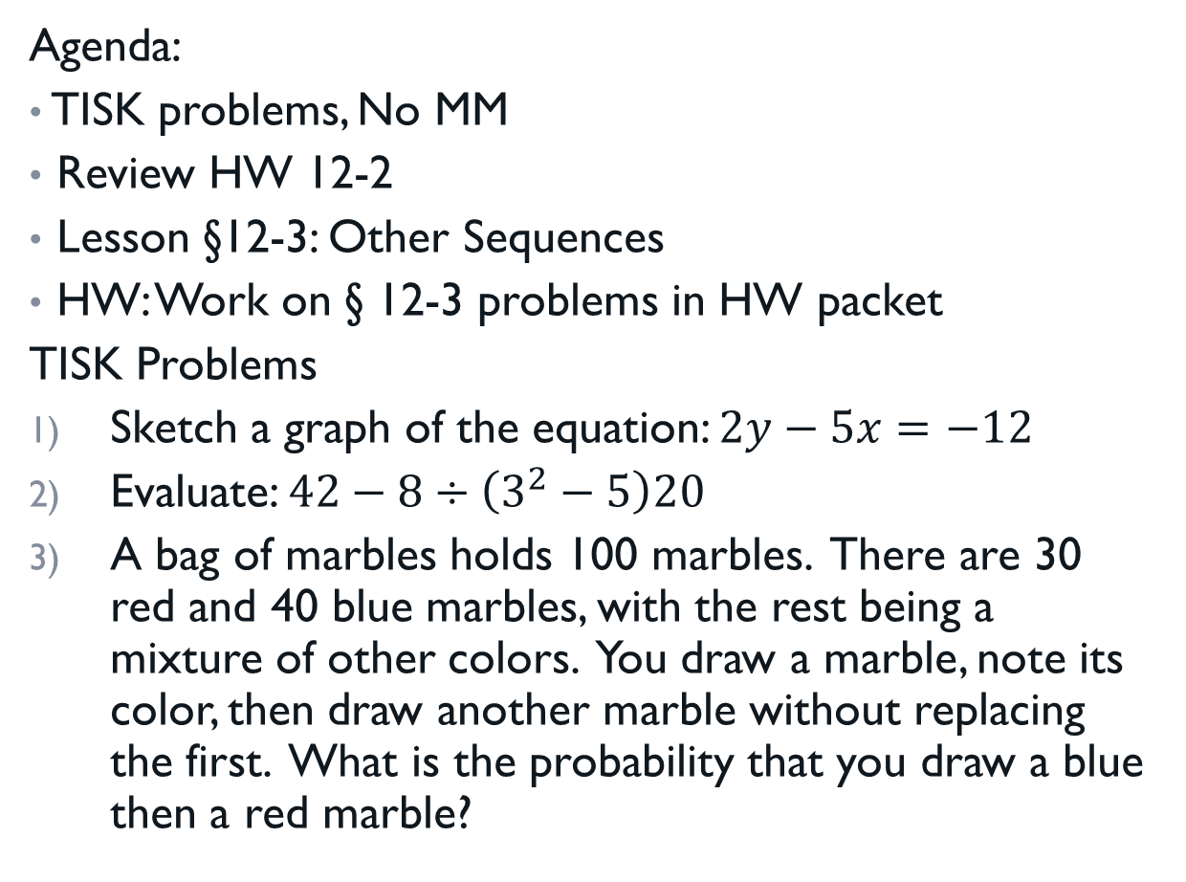
Wednesday, January 23, 2013
Agenda:
TISK problems, No MM
Review HW 12-2
Lesson §12-3: Other Sequences
HW: Work on § 12-3 problems in HW packet
TISK Problems
Sketch a graph of the equation: $2y−5x=−12$
Evaluate: $42−8÷\left(3^{2}−5\right)20$
A bag of marbles holds 100 marbles. There are 30 red and 40 blue marbles, with the rest being a mixture of other colors. You draw a marble, note its color, then draw another marble without replacing the first. What is the probability that you draw a blue then a red marble?

Slide 2
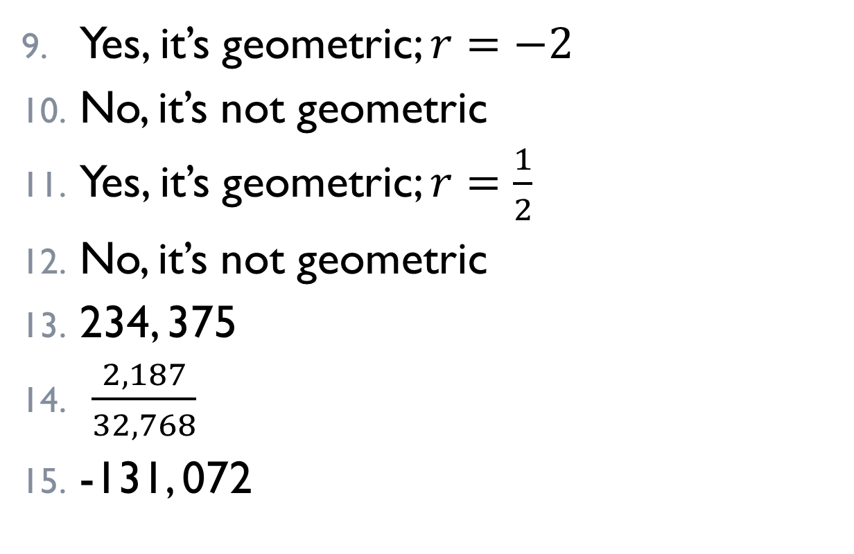
Homework Check
Yes, it’s geometric; $r=−2$
No, it’s not geometric
Yes, it’s geometric; $r=\frac{1}{2}$
No, it’s not geometric
234, 375
$\frac{2,187}{32,768}$
-131, 072

Slide 3
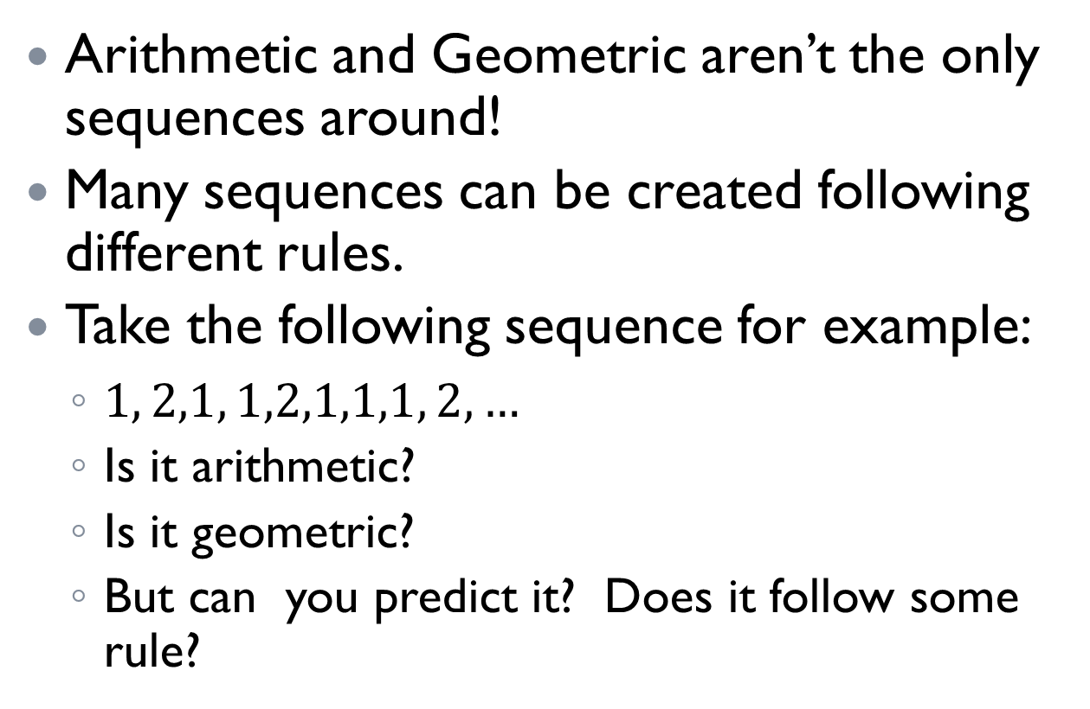
§12-3 Other Sequences
Arithmetic and Geometric aren’t the only sequences around!
Many sequences can be created following different rules.
Take the following sequence for example:
  $1, 2,1, 1,2,1,1,1, 2,…$
  Is it arithmetic?
  Is it geometric?
  But can you predict it? Does it follow some rule?

Slide 4
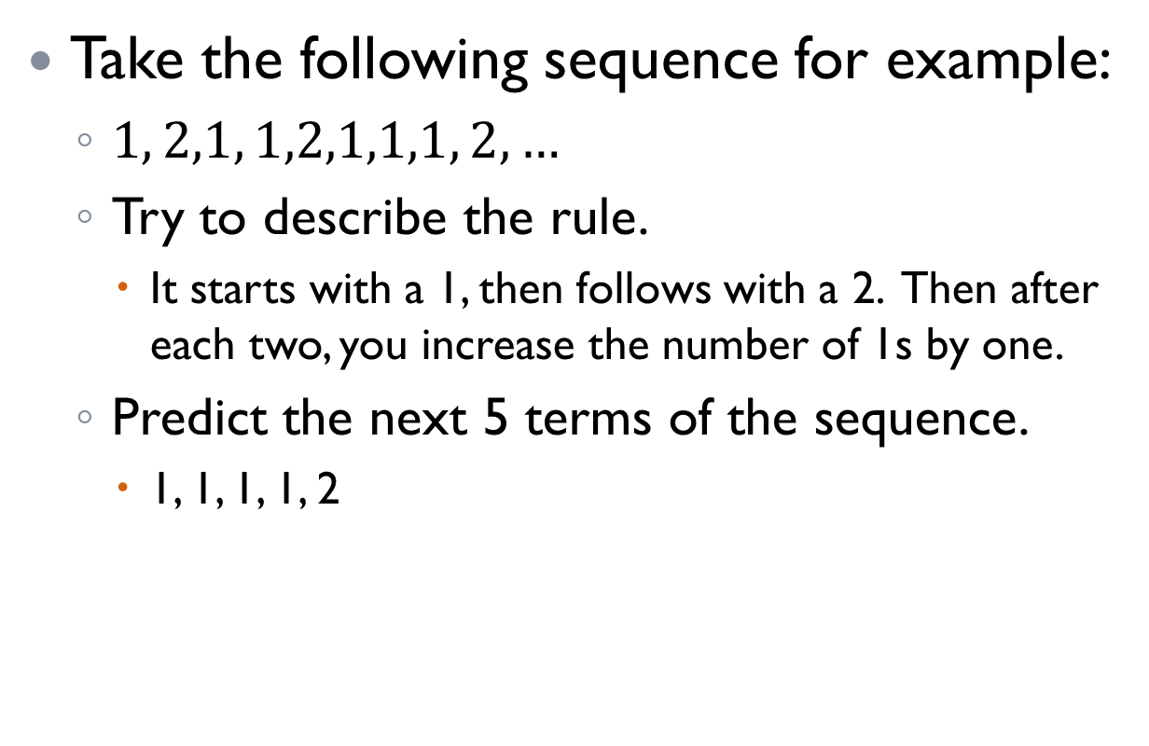
§12-3 Other Sequences
Take the following sequence for example:
  $1, 2,1, 1,2,1,1,1, 2,…$
  Try to describe the rule.
    It starts with a 1, then follows with a 2. Then after each two, you increase the number of 1s by one.
  Predict the next 5 terms of the sequence.
    1, 1, 1, 1, 2

Slide 5
§12-3 Other Sequences
2, 3, 5, 7, 11, 13, 17, …
  Is it a geometric sequence?
  Is it an arithmetic sequence?
  Is there anything special about these numbers?
    The numbers are the prime numbers from least to greatest.
    That’s our “rule”.
  What are the next three terms?
    19, 23, 29

Slide 6
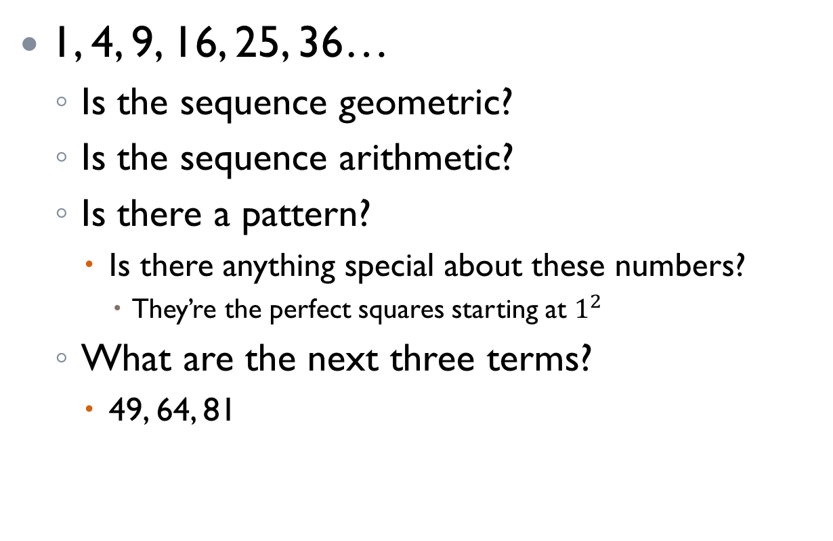
§12-3 Other Sequences
1, 4, 9, 16, 25, 36…
  Is the sequence geometric?
  Is the sequence arithmetic?
  Is there a pattern?
    Is there anything special about these numbers?
      They’re the perfect squares starting at $1^{2}$
  What are the next three terms?
    49, 64, 81

Slide 7
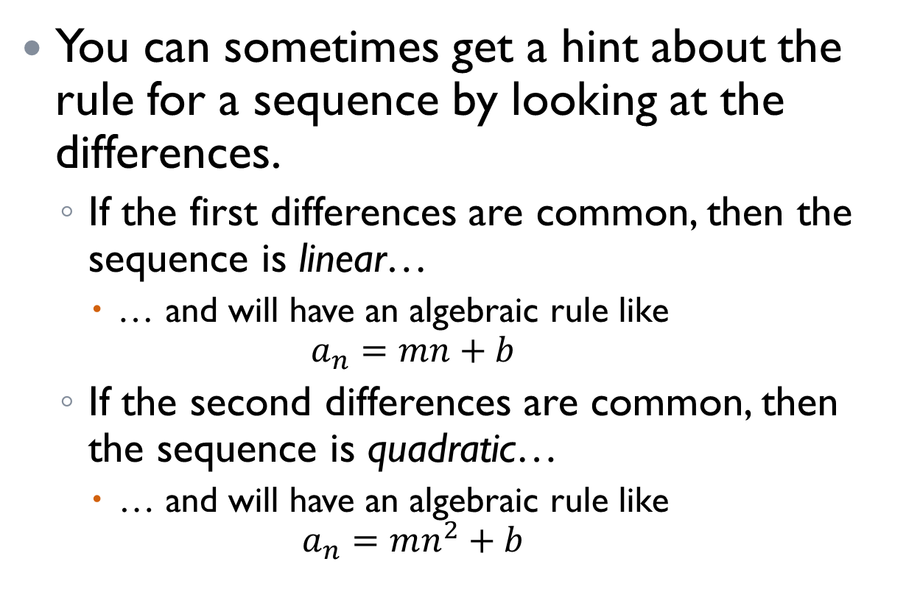
§12-3 Other Sequences
You can sometimes get a hint about the rule for a sequence by looking at the differences.
  If the first differences are common, then the sequence is linear…
    … and will have an algebraic rule like
    $a_{n}=mn+b$
  If the second differences are common, then the sequence is quadratic…
    … and will have an algebraic rule like
    $a_{n}=mn^{2}+b$

Slide 8

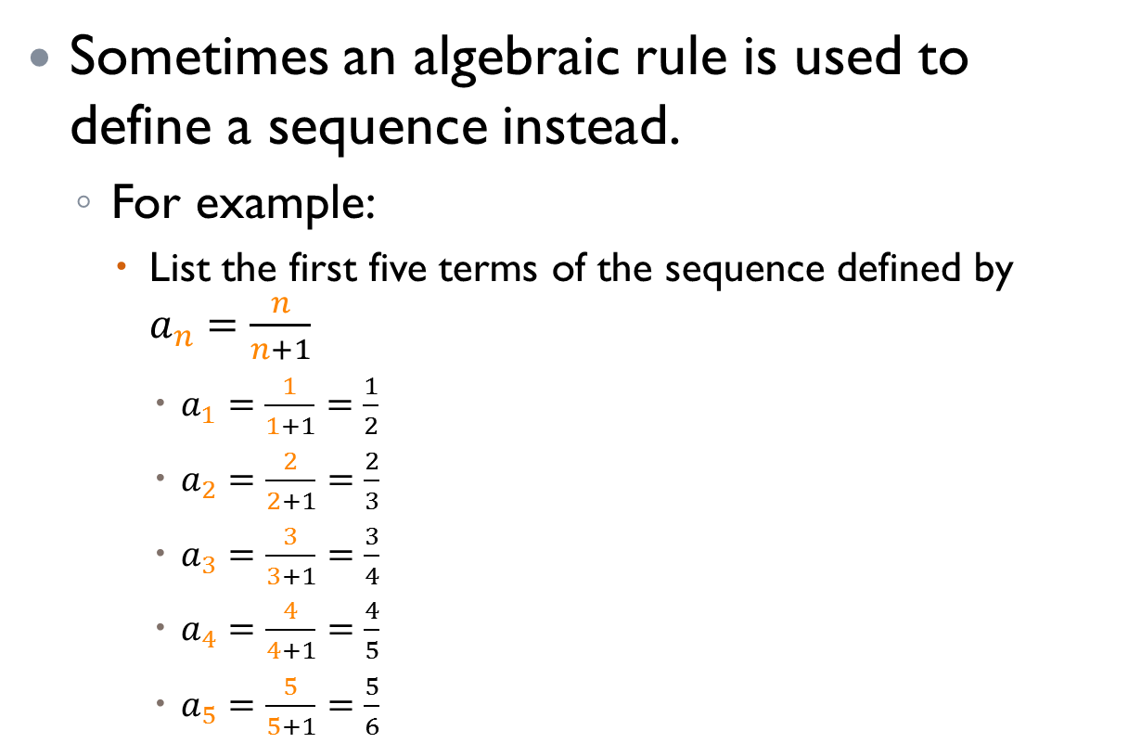
§12-3 Other Sequences
Sometimes an algebraic rule is used to define a sequence instead.
  For example:
    List the first five terms of the sequence defined by $a_{n}=\frac{n}{n+1}$
      $a_{1}=\frac{1}{1+1}=\frac{1}{2}$
      $a_{2}=\frac{2}{2+1}=\frac{2}{3}$
      $a_{3}=\frac{3}{3+1}=\frac{3}{4}$
      $a_{4}=\frac{4}{4+1}=\frac{4}{5}$
      $a_{5}=\frac{5}{5+1}=\frac{5}{6}$
Another way to describe this sequence is that “the numerator and the denominator increase by one from term to term starting at $\frac{1}{2}$.”

Slide 9
§12-3 Other Sequences
Some sequences follow other rules.
One very famous such sequence is called the Fibonacci sequence.
  The Fibonacci sequence was discovered by Loenardo Pisano Bigollo, aka Leonardo Fibonacci, an Italian mathematician.
  His sequence is simple.
    Start with the numbers 1, 1…
    Then add the previous two terms together to get the next term: 1 + 1 = 2
      1 + 2 = 3
      2 + 3 = 5
      5 + 3 = 8
      8 + 5 = 13
      And so on… 1, 1, 2, 3, 5, 8, 13, …

Slide 10
§12-3 Other Sequences
Why is the Fibonacci sequence so famous?
  It’s seen in SO MANY places in nature!
Watch this video to find out more…
  www.youtube.com/watch?v=ahXIMUkSXX0

